Slide 1

SUPERVISORY SKILLS
MAP-ID
MUSASHI AUTO PARTS INDIA PVT. LTD.
MAP-ID② BENGALURU
【 TRAINING】
SOFT SKILLS:-
SUPERVISORY DEVELOPMENT
PROGRAM

Slide 2



Supervisor:-
Skills for Success
SUPERVISORY SKILLS

Slide 3


What does the company expect from supervisors?
SUPERVISORY SKILLS
Stay aware of the big picture
Create a productive environment for your employees
Make decisions on your own
Implement new programs and methods
Inform your people about company policies and procedures
Teach effectively

Slide 4

The Role of the Supervisor
SUPERVISORY SKILLS
Setting goals
Demonstrating effective behaviors
Decision-making
Managing Change
Time Management
Communication Skills
Effective Meeting Skills
Motivation
Delegation
Training

Slide 5

Set personal and professional goals
SUPERVISORY SKILLS
Write down your goals
Discuss with your supervisor and your team
Review often

Slide 6

Take action to get ideas and plans accepted
SUPERVISORY SKILLS
Get employee support
Convince your supervisor and senior management

Slide 7
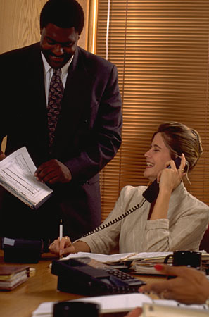
Effective behaviors
SUPERVISORY SKILLS
Patience
Tolerance
Sensitivity
Empathy
Decisiveness
Sense of humor

Slide 8

Decision Making
SUPERVISORY SKILLS
Be truly open-minded
Avoid taking sides
Recognize your own bias
Don’t let titles or prestige influence your decisions
Avoid absolute wordings in your decisions

Slide 9



Questions to ask before making a decision
SUPERVISORY SKILLS
Do I have enough information to make a decision?
What would be the worst possible result if I make that decision?
Do I need to make a decision at this time?
Am I the best person to make the decision?

Slide 10


Don’t be afraid to take a risk
SUPERVISORY SKILLS
Make that tough decision
Believe in it and promote it
Sell it

Slide 11
Before selling your decision
SUPERVISORY SKILLS
What information should be provided?
What medium will be the most effective?
Is my presentation phrased in language that will gain support for the decision?
What negative responses might I receive?
When and how will I present?
What questions are likely to come up?

Slide 12
Sell your decisions to the following:
SUPERVISORY SKILLS
Immediate supervisor
Other supervisors that need to be informed
Employee affected by the decision
Employees indirectly affected

Slide 13
To manage change:
SUPERVISORY SKILLS
Determine the method for introducing and selling the change to your team
Break the change down into smaller steps
Create a contingency plan
Monitor the implementation of the change, including results and behaviors
Accept and plan for the results of change

Slide 14
Sell the change
SUPERVISORY SKILLS
Present the change to employees in clear and specific language
Put your ideas in a positive, constructive light
Stress your willingness to help employees adapt
Ask employees how they plan to deal with it
If change has unintended results, be open to review

Slide 15


This stimulating training game allows participants to:
SUPERVISORY SKILLS

Slide 16

Managing Your Time
SUPERVISORY SKILLS
What are some timewasters?

Slide 17
How to manage your time
SUPERVISORY SKILLS
Prioritize your work
  Assess how you are currently spending your time
To do lists
Plan your tasks daily
Evaluate time management several times during the day

Slide 18
Communication Skills
SUPERVISORY SKILLS
Present one idea at a time
Keep it simple
Make it brief
Personalize it to the other person
Use the right tone of voice and body language
Get acceptance of each idea
Respond to the emotions of the person
Appreciate your listener’s concerns
Encourage listeners to express themselves

Slide 19

Steps to improve listening skills
SUPERVISORY SKILLS
Ask questions
Concentrate – stay focused
Identify the main idea
Listen for the rationale
Listen for key words
Organize in your mind
Take notes

Slide 20

Role of the Facilitator
SUPERVISORY SKILLS
Stay calm – don’t take sides
Keep on the agenda
Start and end the meeting on time
Encourage participation

Slide 21

Praise with a reason
SUPERVISORY SKILLS
Mean what you say
Balance your praise
Immediately after the event
Public or private

Slide 22
Criticism
SUPERVISORY SKILLS
Do it as quickly as you can after discovering the problem
Limit comments to the person’s actions in this situation
Let them do some of the talking
Be considerate
Don’t mix criticism with praise
Don’t play psychiatrist
Make it private

Slide 23
Effective Delegation Skills
SUPERVISORY SKILLS
Improves productivity
Can concentrate on supervisory responsibilities
Develops skills in others
More job satisfaction for employees
Helps evaluate people

Slide 24

How to delegate better?
SUPERVISORY SKILLS
Clearly define what you want your employees to do
Encourage people to learn and make their own decisions
Don’t take an assignment back after you’ve delegated it

Slide 25
How to deal with the needs of your employees:
SUPERVISORY SKILLS
Be courteous, friendly and interested
Offer assistance when needed
Listen patiently
Observe their work and give them feedback
Make goals reasonable

Slide 26
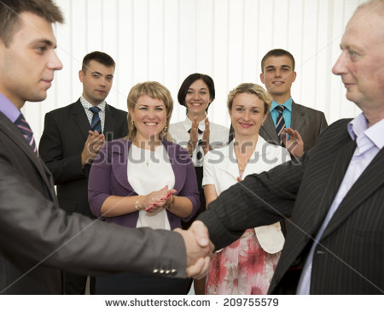

What do employees want from their jobs?
SUPERVISORY SKILLS
Appreciation
Recognition
Involvement with the company
Comfortable work environment
Reward in returns of
Money after hard work

Slide 27

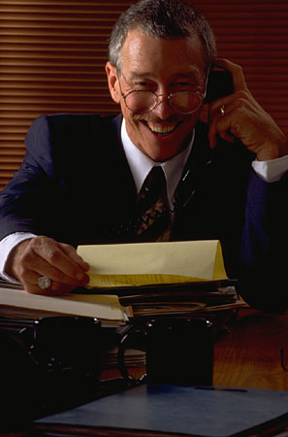
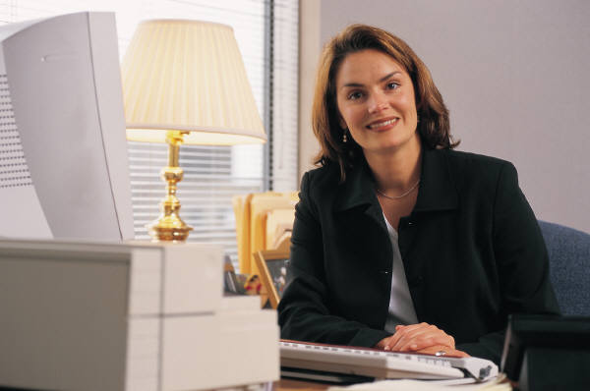
What else?
SUPERVISORY SKILLS
Security and stability
Social needs
Independence

Slide 28
SUPERVISORY SKILLS
1. Know your people.
Take time to offer a friendly greeting at the beginning of each workday. You will be amazed at how your greeting in the morning can set the tone of an employee’s attitude all day. A “grumpy” boss will most likely have “grumpy” employees. Let employees know that you care about them as individuals. So, talk to them occasionally about their outside interests.
2. Give plenty of feedback.
Let people know you really do notice the work they do. Make specific comments about the work they do. For example, instead of just telling a person they did a good job, be specific about what was really good about their work. You might say, "I really liked the amount of detail you put into that report." If it is details you want, give feedback on the amount of details they give. Also, expect inexperienced workers to make some mistakes. So, when mistakes are made with new tasks, assume first that your instructions were not clear, and take the time to clarify the expectations.

Slide 29
SUPERVISORY SKILLS
3. Never ignore non-performance.
When you recognize someone is not meeting job expectations, check to see what’s happening. Identify and discuss the problem performance with the employee and let the worker know that you expect performance.
4. Praise workers who do what’s expected of them.
Remember, a pay check is not sufficient recognition for satisfactory job performance. Just praising the exceptional performance will mean few employees will be praised. It’s easy to praise top performers, but don't forget the rest. Take the time to show those who regularly perform their work adequately that you appreciate their efforts. Remember, good performance gone unrecognized will diminish. If you don't show you care about what they do, why should they care? If you don't show you appreciate them, why should they appreciate you? I could go on, but you get the idea.
5. Remember the work atmosphere.
The most important part of the work climate is a healthy sense of self-esteem. When employees feel good about themselves and they feel good about what they do it is much easier for them to be cooperative and display a willingness to go the extra mile for you. When you think about it, the attitude of the boss is the most important attitude of all.

Slide 30
Evaluation Questions
SUPERVISORY SKILLS
Use:
  a. Strongly agree
  b. Agree
  c. Disagree
  d. Strongly disagree
  e. Don’t know
I found the presentation of material easy to understand.
This discussion session increased my knowledge on the subject presented.
I will be able to use some of the information from this discussion session in the future.
The presenter was well prepared for this discussion session.
This presentation should be repeated in future semesters.

